Slide 1
Introduction to Machine Learning
Linden Lu

Slide 2
Introduction to Machine Learning
Introduction to Machine Learning
Introduction to Data Preprocessing
Introduction to Machine Learning Algorithms

Slide 3
Best Practice
Read the lesson Jupyter Notebooks briefly.
Watch lesson videos thoroughly.
Revisit the lesson Jupyter Notebooks thoroughly.

Slide 4
Module Objectives
By the end of this module, you will be able to:
Articulate different types of machine learning algorithms.
Understand the purpose of data preprocessing.
Perform data preprocessing with Python.

Slide 5
Introduction to Machine Learning
Linden Lu

Slide 6
Introduction to Machine Learning
AI, Machine Learning, and Deep Learning
Machine Learning Algorithms

Slide 7
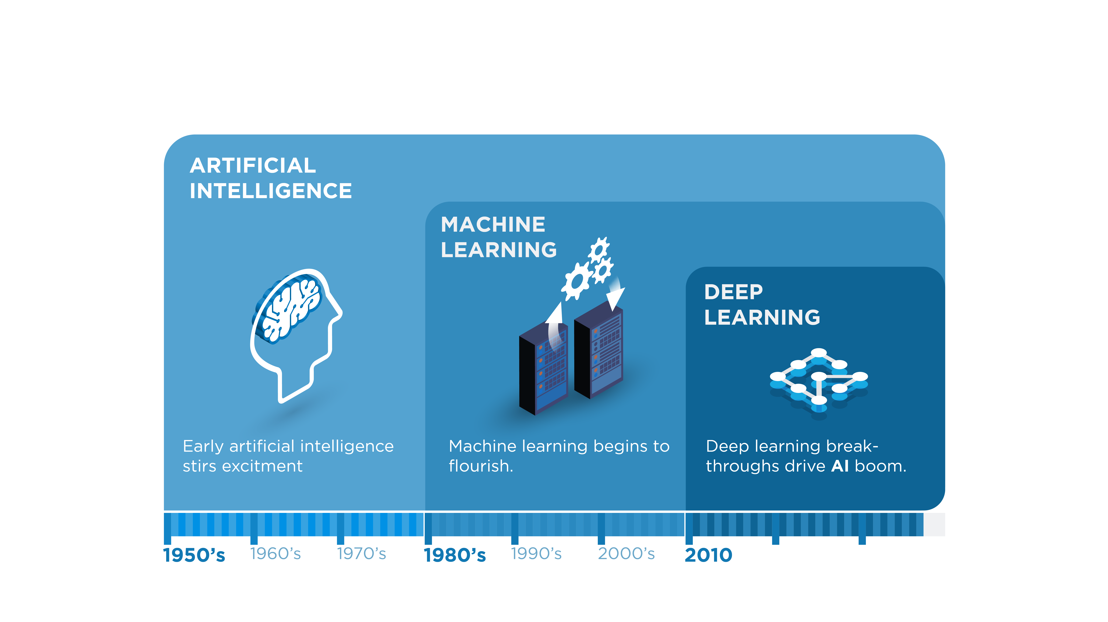
Artificial Intelligence, Machine Learning, and Deep Learning
Lucasfilm / 20th Century Fox / http://tinyurl.com/skpv9fm

Slide 8
Machine Learning
Supervised learning
Classification
Regression
Unsupervised learning
Clustering

Slide 9
Machine Learning Algorithms
Classification
Regression
Text Analysis
Clustering
Time Series Analysis

Slide 10
Introduction to Data Preprocessing
Linden Lu

Slide 11

CRSIP-DM Model Review
© 2012 Kenneth Jensen / CC BY-SA 3.0 / http://tinyurl.com/yxuuhnyx

Slide 12
Data Preprocessing Techniques
Categorical Variables Encoding
Data Set Splitting
Data Scaling and Standardizing

Slide 13
Categorical Variables
Nominal
Categories have no numerical orders.
Gender, Color
Ordinal
Categories have numerical orders.
Rank in race, Size

Slide 14
Categorical Variable Encoding
Label Encoding
Encode to unique numeric values.
One Hot Encoding
Create a dummy variable with value 0 and 1 for each category value.
Ordinal Encoding
Encode categories to ordered numerical values.
Small->0, Medium->1, Large->2

Slide 15
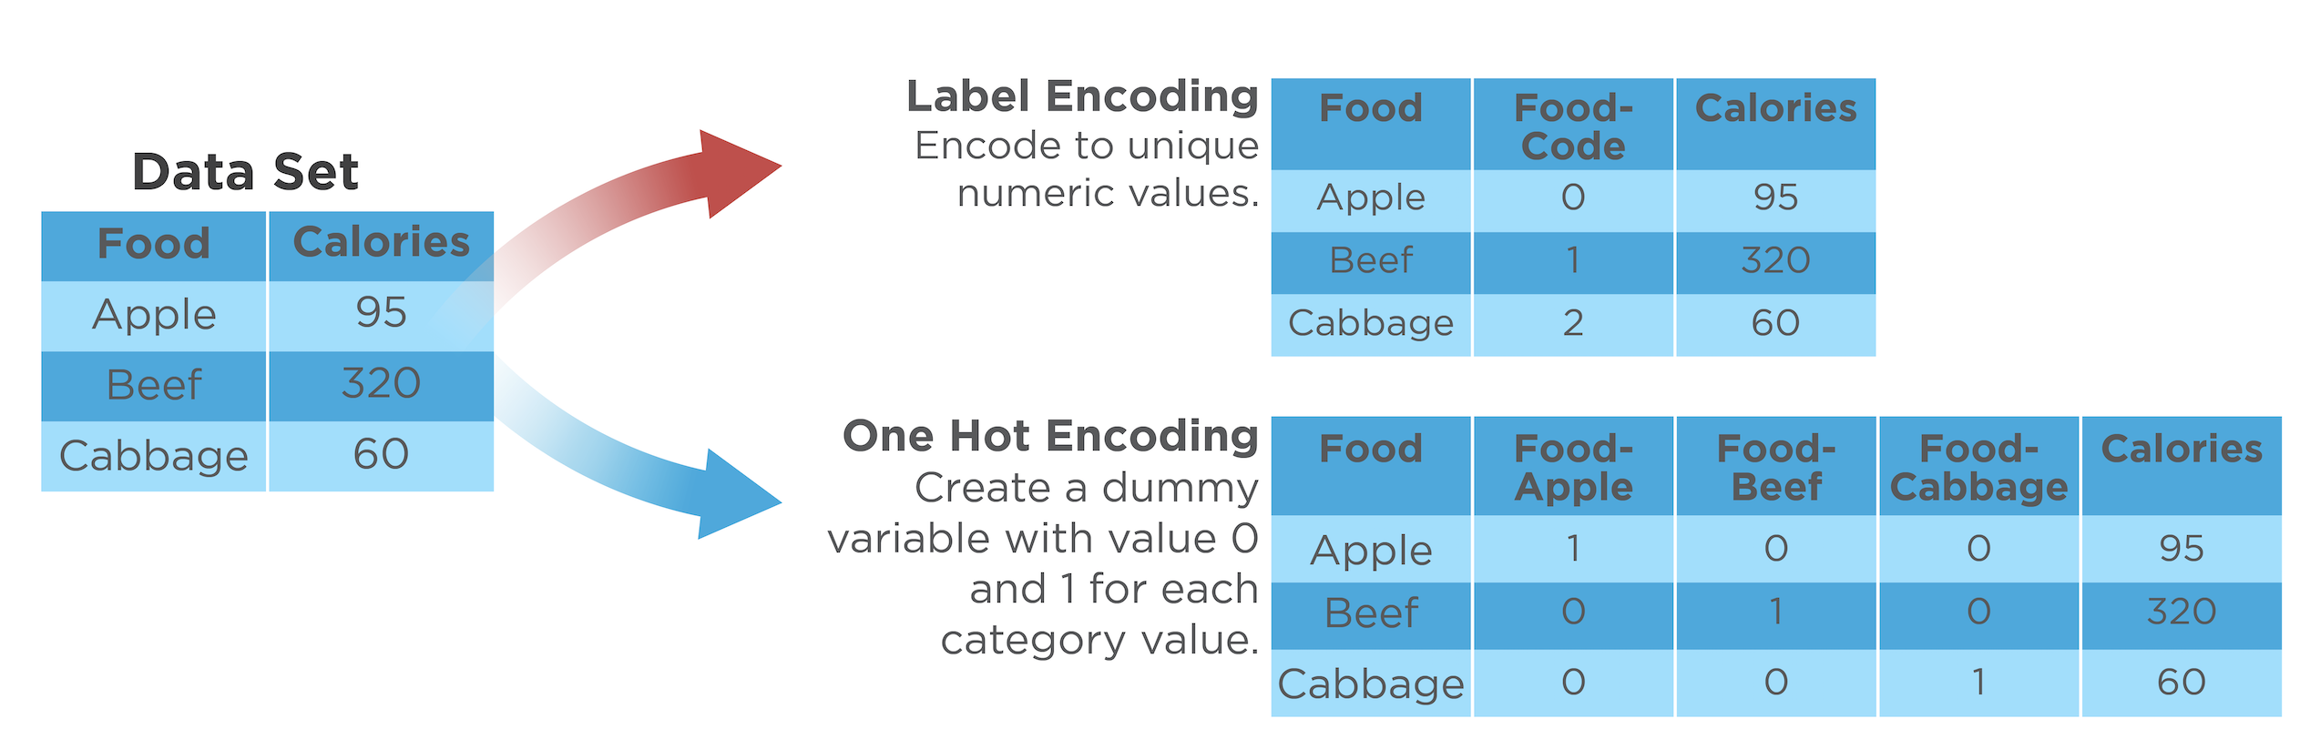
Label Encoding and One Hot Encoding

Slide 16
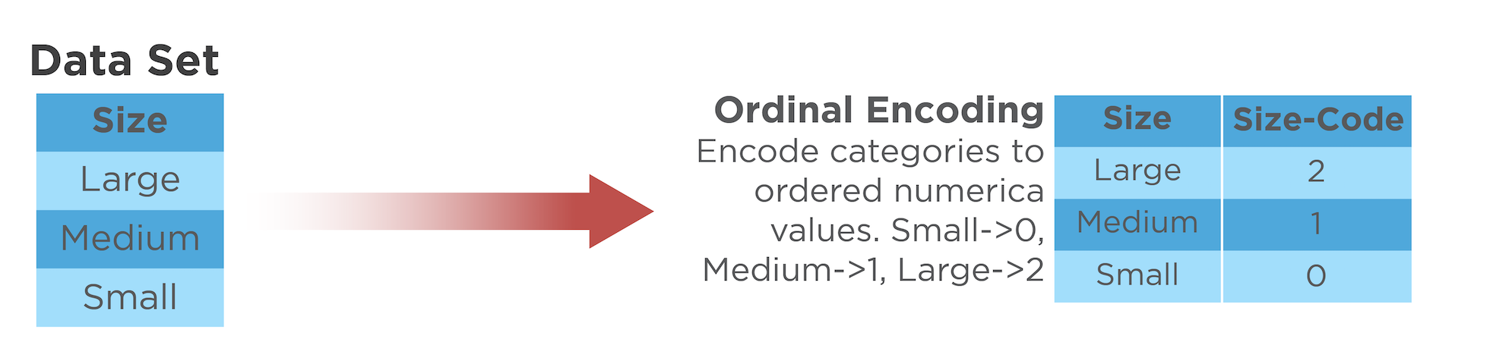
Ordinal Encoding

Slide 17
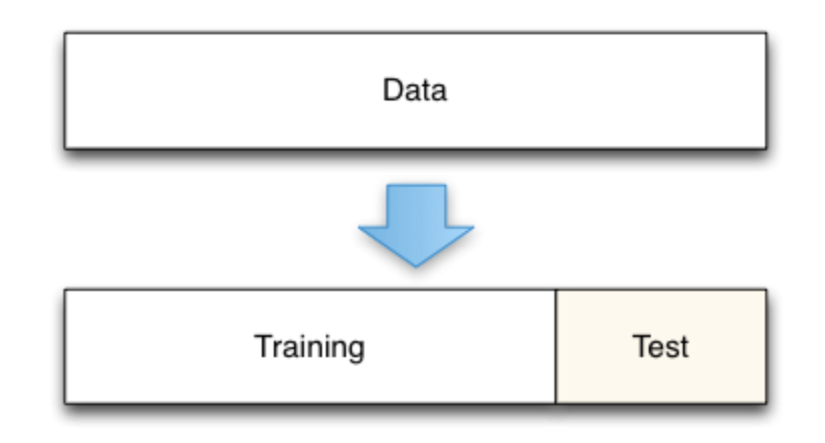
Dataset Splitting

Slide 18
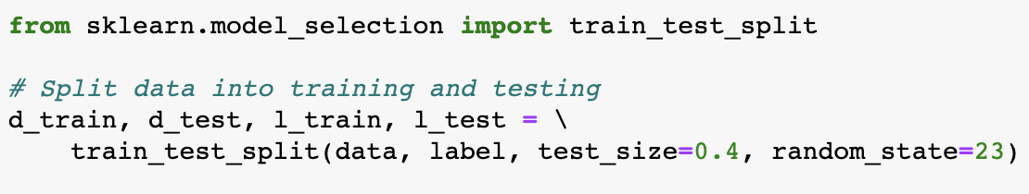
Dataset Splitting

Slide 19
Data Scaling
Standardizing
Zero mean and one standard deviation
Normalization
Scale to same range, normally 0 to 1

Slide 20
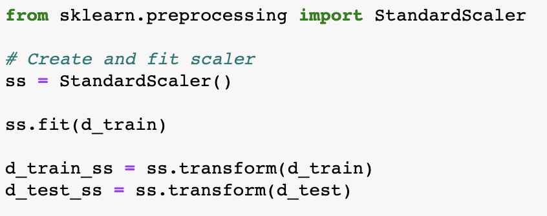
Data Scaling

Slide 21
Introduction to Machine Learning Algorithms
Linden Lu

Slide 22
Iris Dataset
 | sepal_length | sepal_width | petal_length | petal_width | species
25 | 5.0 | 3.0 | 1.6 | 0.2 | setosa
127 | 6.1 | 3.0 | 4.9 | 1.8 | virginica
16 | 5.4 | 3.9 | 1.3 | 0.4 | setosa
105 | 7.6 | 3.0 | 6.6 | 2.1 | virginica
102 | 7.1 | 3.0 | 5.9 | 2.1 | versicolor

Slide 23
Modeling with Scikit-Learn
Preprocess data
Create model
Train the model
Evaluate the model
Predict with the model

Slide 24
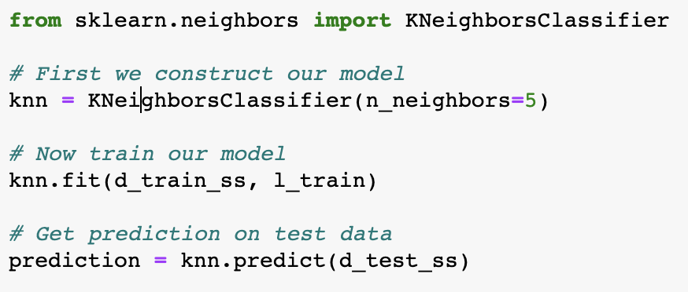
Modeling with Scikit-Learn

Slide 25
References
Lucasfilm. (n.d.). C3PO. Los Angeles: 20th Century Fox. Retrieved from http://tinyurl.com/skpv9fm
Jensen, K. (2012). A diagram showing the relationship between the different phases of CRISP-DM and illustrates the recursive nature of a data mining project. Retrieved from https://commons.wikimedia.org/wiki/File:CRISP-DM_Process_Diagram.png

